Slide 1
Preliminary Design Slides
February 6th 2023
Team Laser Pong
Dominic Benintendi, Aditya Sahi, Ian Gant, Andrew Edmonds

Slide 2
Summary of Project Description and Initial Plan

Slide 3
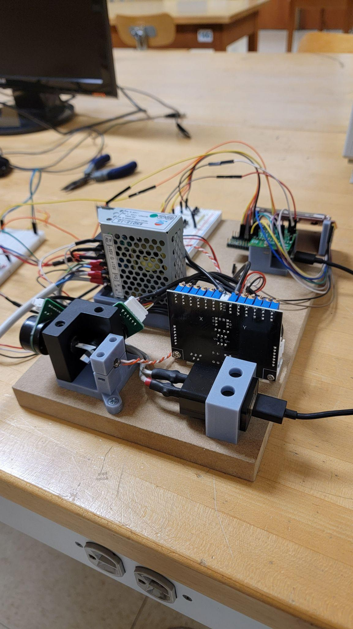
Background
Our goal is to manipulate a laser beam using mirrors in a controlled manner such that we can generate vector images. Furthermore, we will use these graphics to implement the classic game of Pong.

Slide 4
Scope
Objectives
Create a design and implement a plan for the project that adheres to the constraints requirements and deliverables
Establish design in hardware
Analyze the design of the project and fix problems that arise
Constraints
$500 dollar budget
Safety Concerns
Must be completed by senior design expo (April 13th, 2022)
Deliverables
Fully operational prototype
A comprehensive design report
Operational manual
Live demonstration

Slide 5
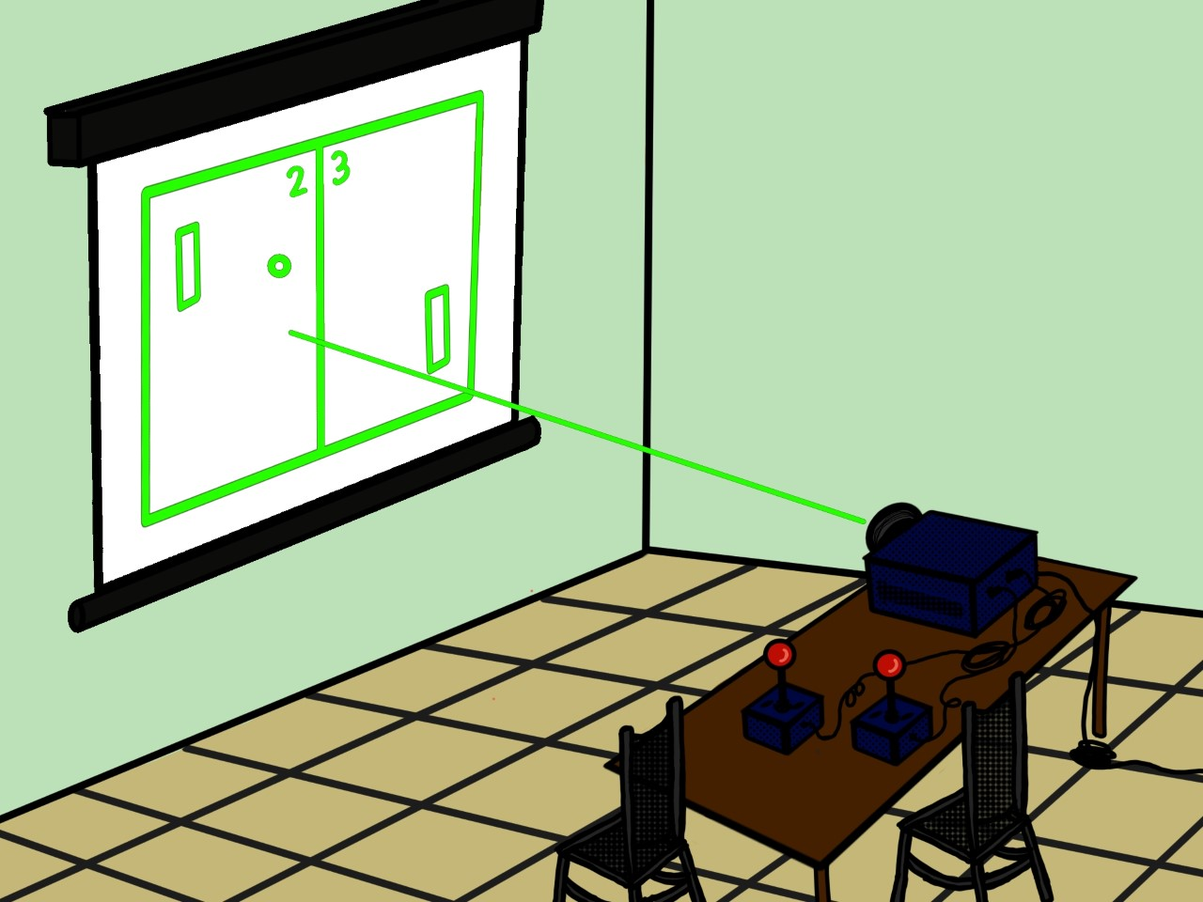
ConOp Digest
Idea
The laser light show project will project the game of pong on a surface using a laser beam. Users will control the game using a set of controller
Gameplay
Two paddles on each side of the screen, The ball will be contained within this box
Projection
Projection of the game is by means of a laser.The device will manipulate a laser beam in a manner quick enough to fool the human eye. This allows the device to create drawings or animations using the moving beam.

Slide 6
Summary of Technical Approach

Slide 7
Top-Level System Requirements
Functional Requirements
Play a two player game of pong
Display pong game using a controlled laser
System shall support sound effects.
Control pong game using a set of controllers held by the users
Performance Requirements
Refresh rate greater than 20Hz
Controller latency will be less than 10ms
Operational Requirements
Support audio jack
Support fuse
Will work in nominally lighted environments

Slide 8
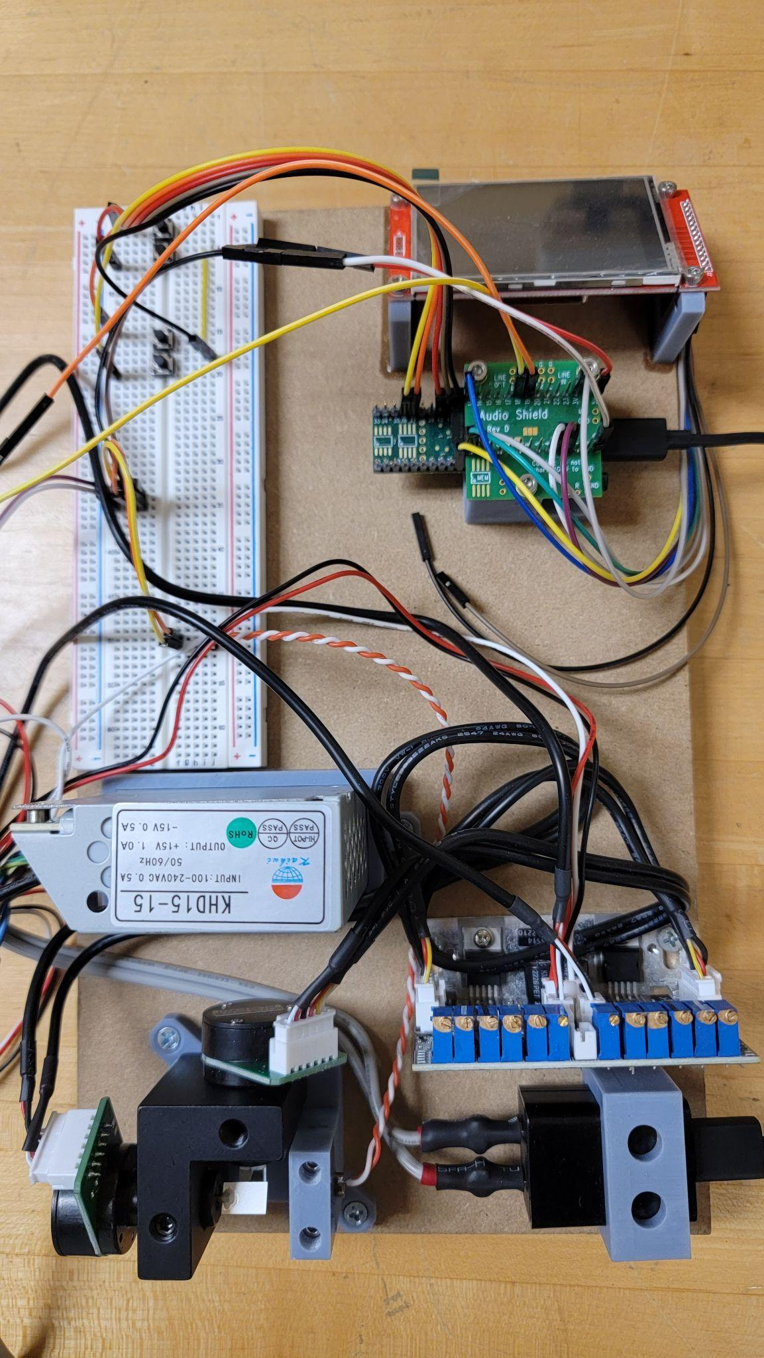
Technical Solution/Approach
Subassemblies
Galvos Motors and Drivers
DAC / DAC signal processing
Teensy 4.1 ( Microcontroller)
Touch Screen
General Purpose Controllers
1mW Single Red Laser
Audio Drivers
Internal Power Supply

Slide 9
Preliminary Design

Slide 10

Galvo and Galvo Driver
Functional requirements
Projecting a vector-based video game graphics onto a two-dimensional rectangular surface using a dynamically steered laser beam.
Implementing a two-player pong-style game.
Animating the motion of the laser in order to simulate a physical ping pong.
Displaying graphical boundaries which indicate the solid edges of the playing area.
Performance requirements
Galvos will operate at 20kpps
Will render pong at least 20 fps
Operational requirements
To be operated in an environment consisting of non-condensing humidity.
Use of Engineering Standards
Differential Signals

Slide 11
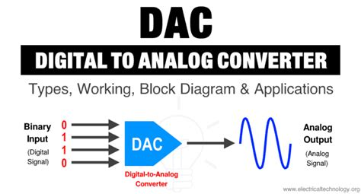
DAC (Digital to Analog)
Functional requirements
The DAC System must take a digital signal from the microcontroller
The DAC System must produce an 0-5v analog signal with the provided digital signal
The DAC System will create two analog signals for each galvo
Performance requirements
The DAC must keep up with the speeds of galvos (20kpps)
The DAC must produce a 5V Analog signal
Use of Engineering Standards
Bus system (I2C, SPI)

Slide 12
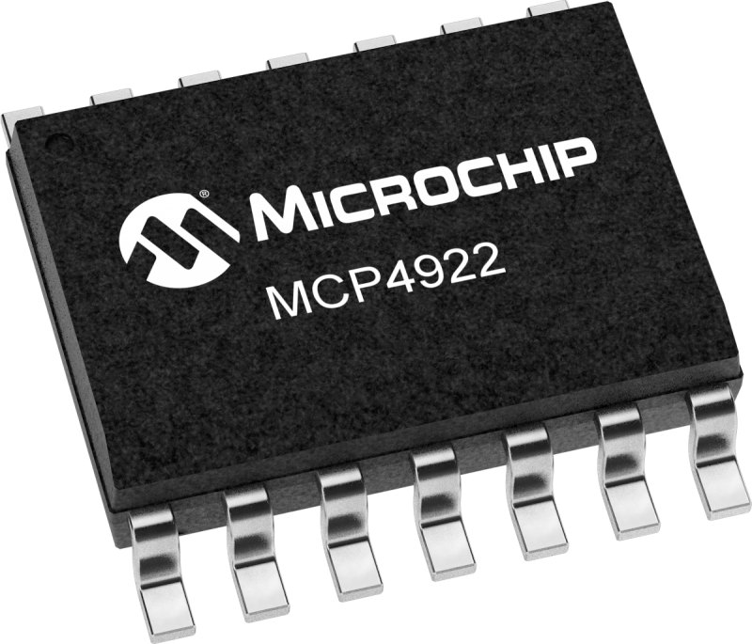
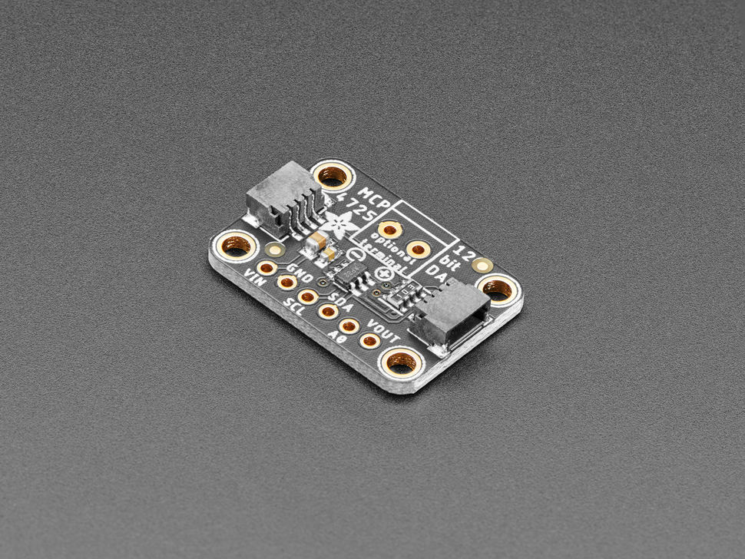
DAC: Trade Study
MCP4922
Uses the SPI Standard
Dual Channel
SMT format
Max 20 MHz Clock Rate
Instruction Buffer for synchronous execution
MCP4725
Uses the I2C Standard
Single Channel
Break-out board format
Max 1 MHz Clock rate
No buffer

Slide 13
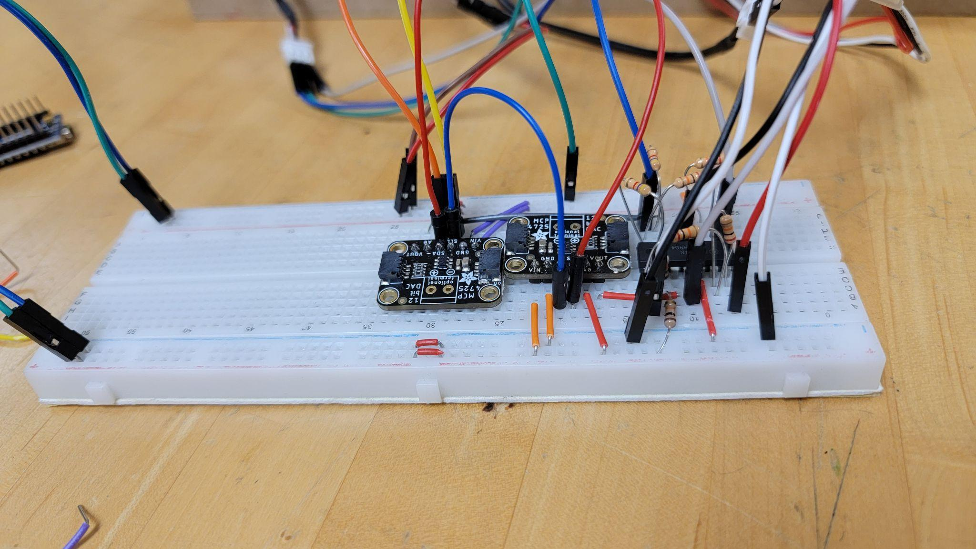
DAC Signal Processing
Functional requirements
The DAC Signal Processing must take the analog signal from the DAC, and use it to move a galvo in its full range of motion
The DAC Signal Processing must process the analog signals for the X dim
The DAC Signal Processing must
process the analog signals for the Y dim
Performance requirements
The DAC Signal Processing must keep up with the speeds of galvos (20kpps)

Slide 14
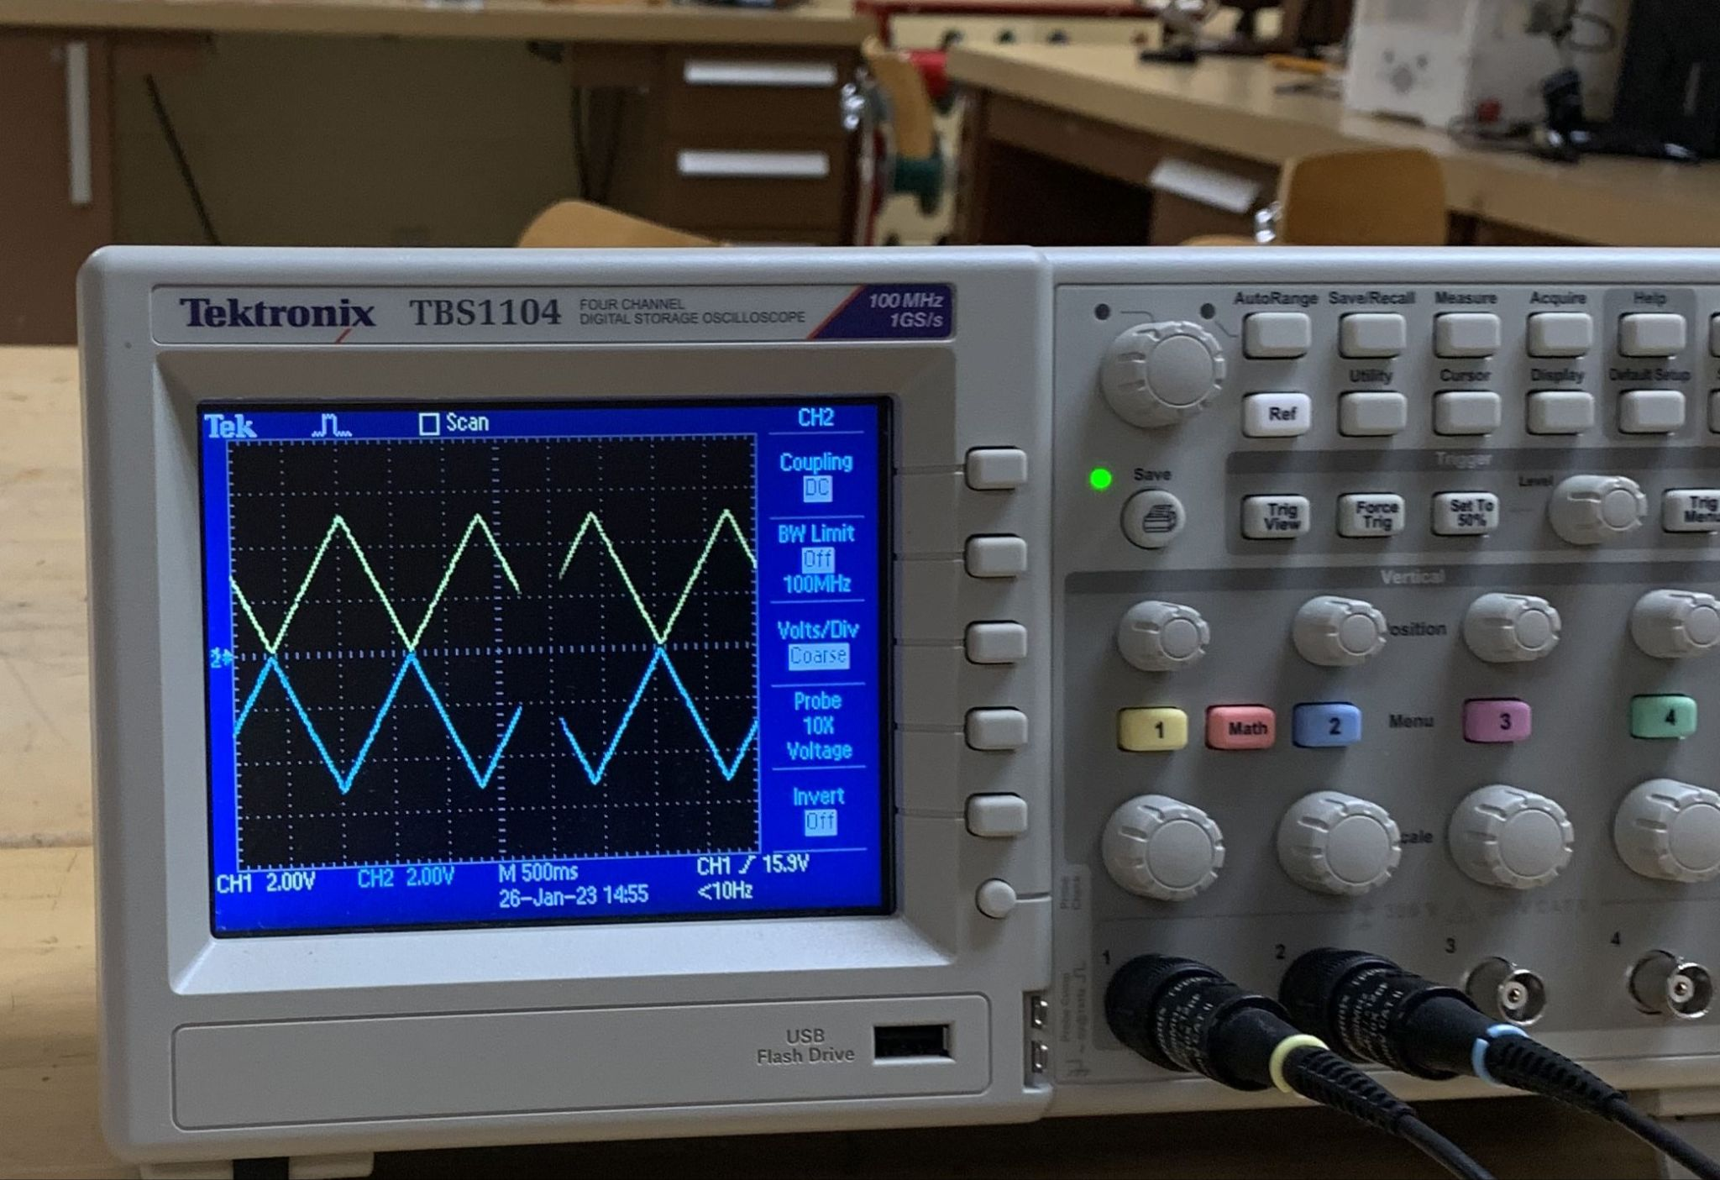
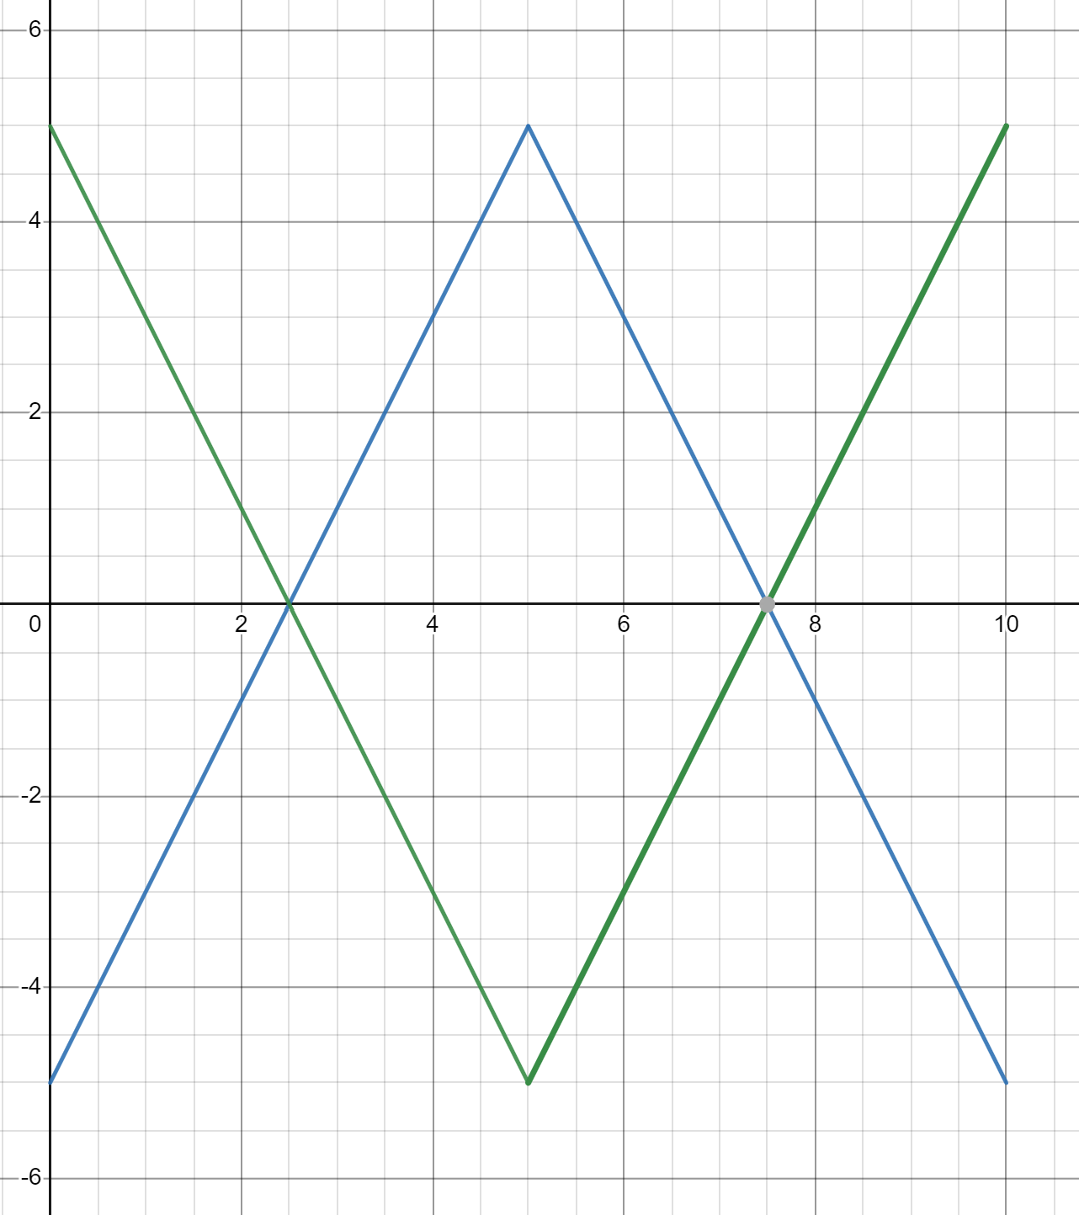
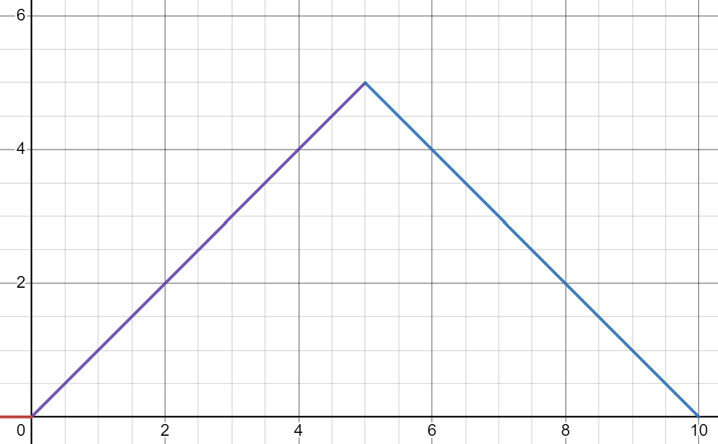
DAC Signal Processing: Cont
Design algorithms and/or formulas
Convert a 0 - 5v signal, to a -5 - 5v differential signal
Example shows a signal galvo, moving from one end of the screen to the other

Slide 15
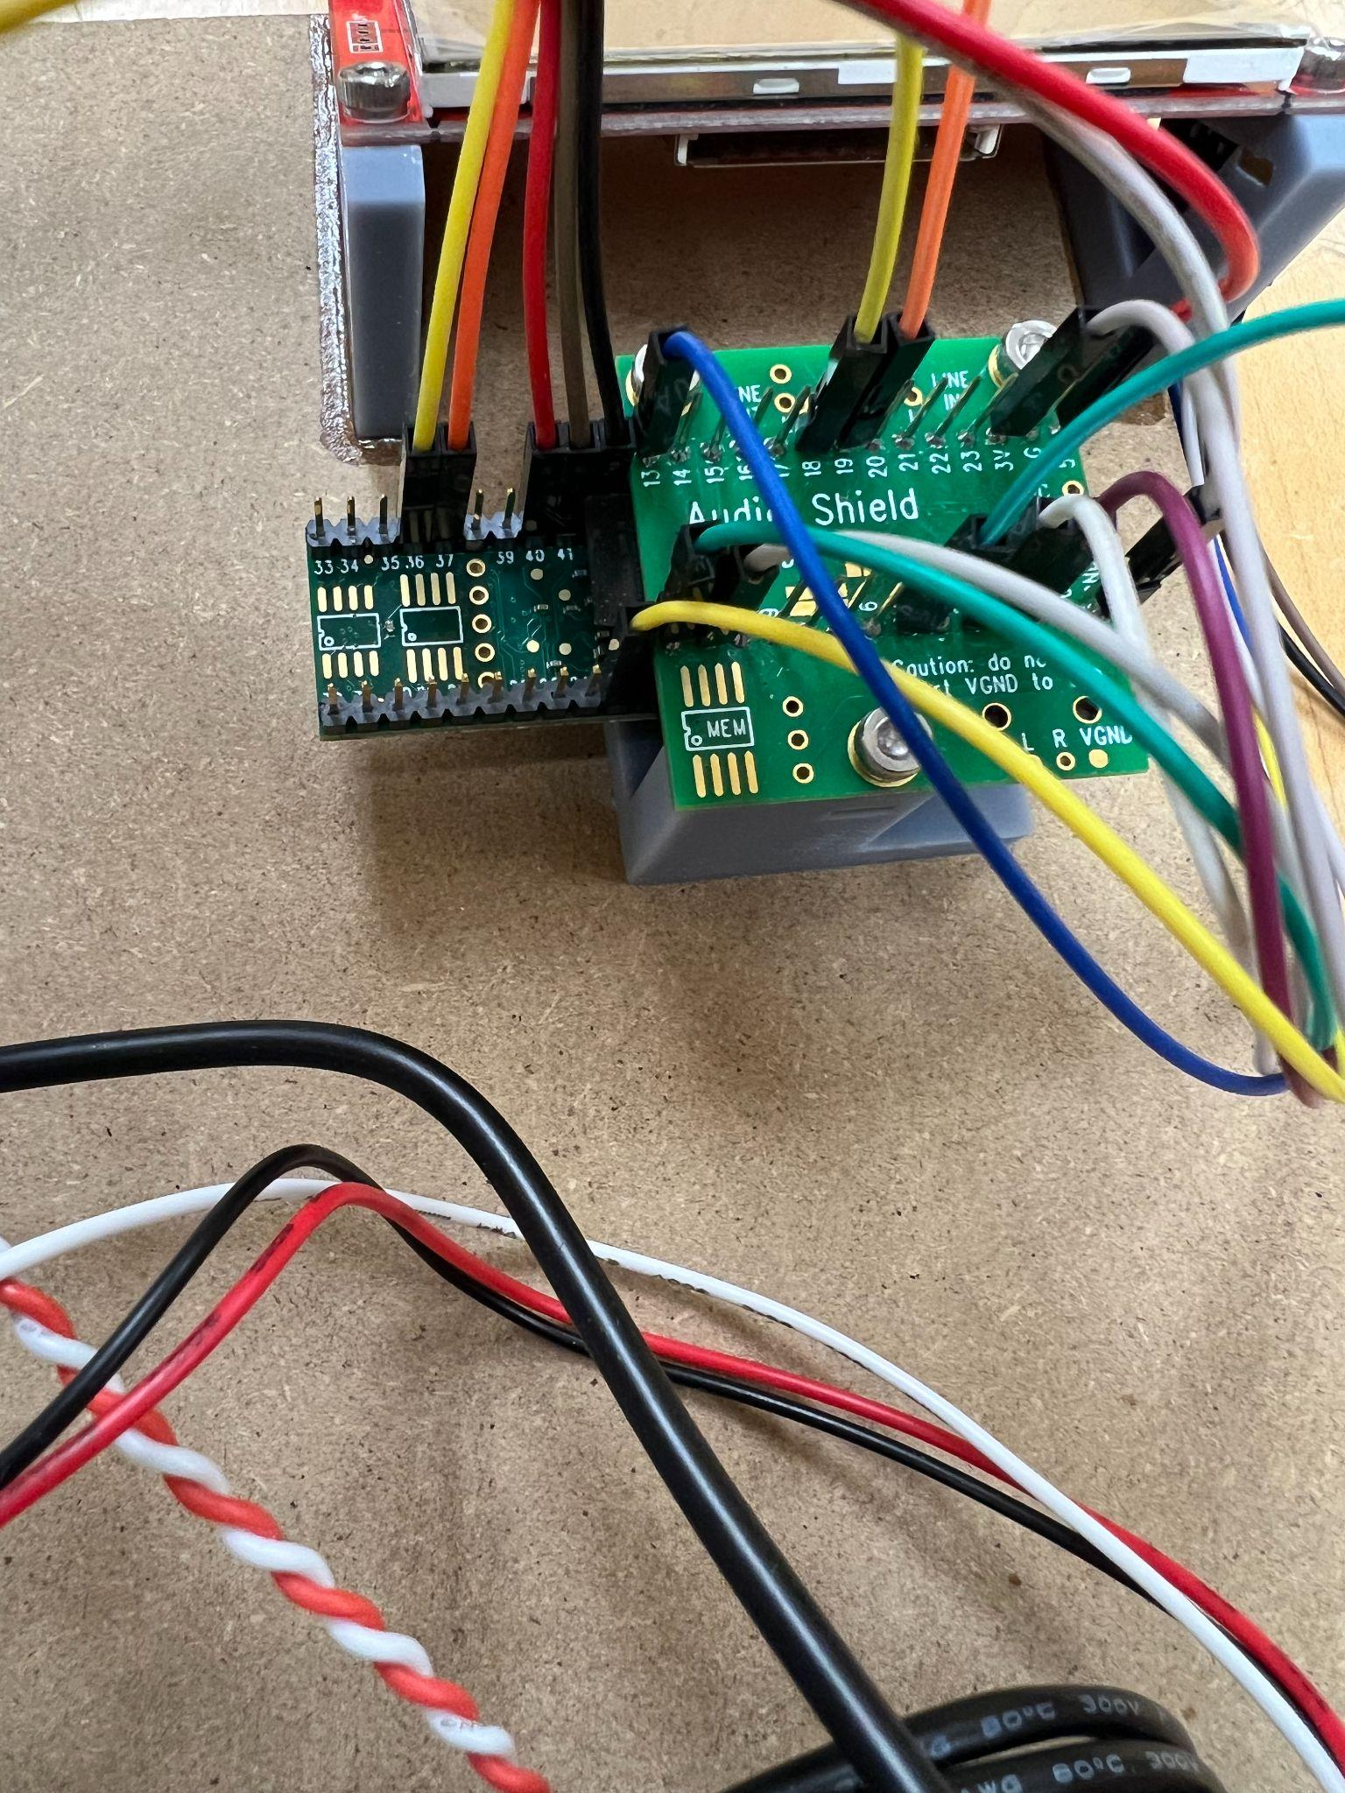
Microcontroller (Teensy 4.1)
Functional requirements
The teensy will interface with the audio shield, touch screen, DACs, galvos and the laser diode
Performance requirements
Teensy processing must be able to support the 20 kpps galvos
Operational requirements
Will operate with 5V input with 3.3V logic

Slide 16
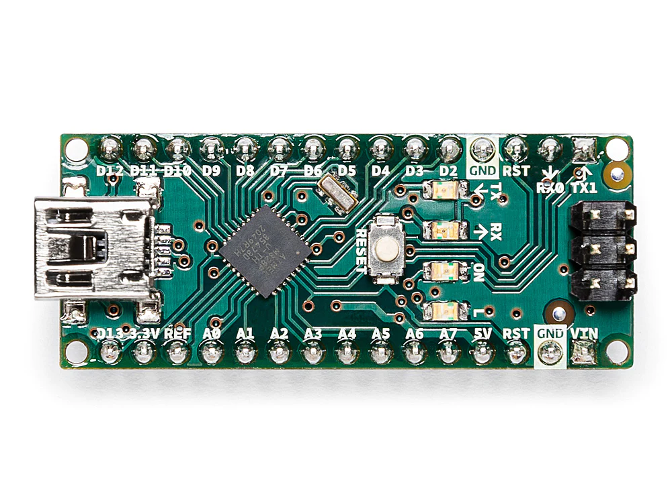
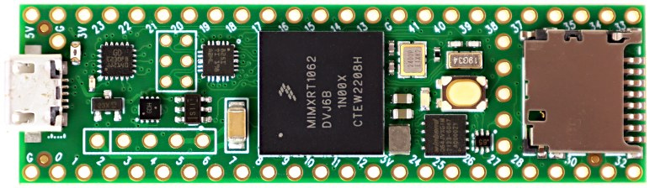
Microcontroller: Trade Study
Teensy 4.1
600 MHz clock speed
55 digital i/o pins
18 analog pins
Micro SD card
Ethernet
Cost: $31.90
Arduino Nano
16 MHz clock speed
22 digital i/o pins
8 analog pins
Cost: $24.90

Slide 17
Touch Screen
Functional requirements
The touch screen will function as an additional i/o option for user input, some examples of this are
Volume control
Game selection
Pause Button
Menu navigation
Game variable modifier
Power off button
The touch screen will accept touch inputs
Performance requirements
The touch screen will have a refresh rate greater than 20hz

Slide 18
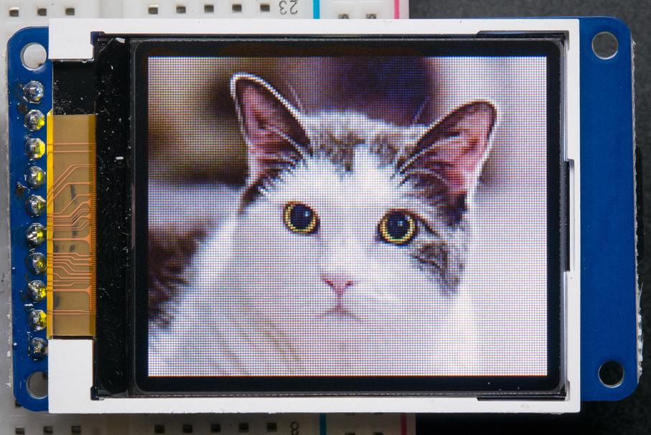
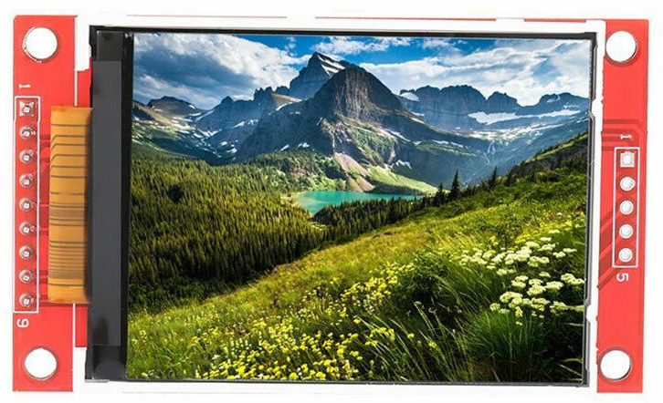
Touchscreen: Trade study
ST7735
1.8” (128x160)
3.3v
SPI
-20~70℃
ILI9341
3.2” (240x320)
3.3v
SPI
-20~70℃

Slide 19
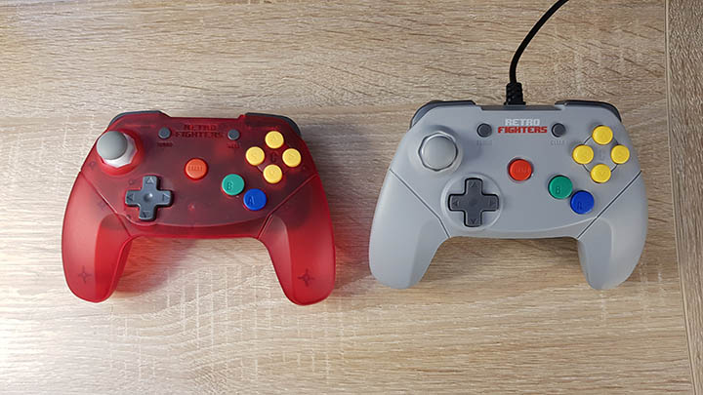
Controllers
I2C
Additional inputs
ESP32
Deep sleep
150 microamps
Less than 10 milliseconds latency

Slide 20
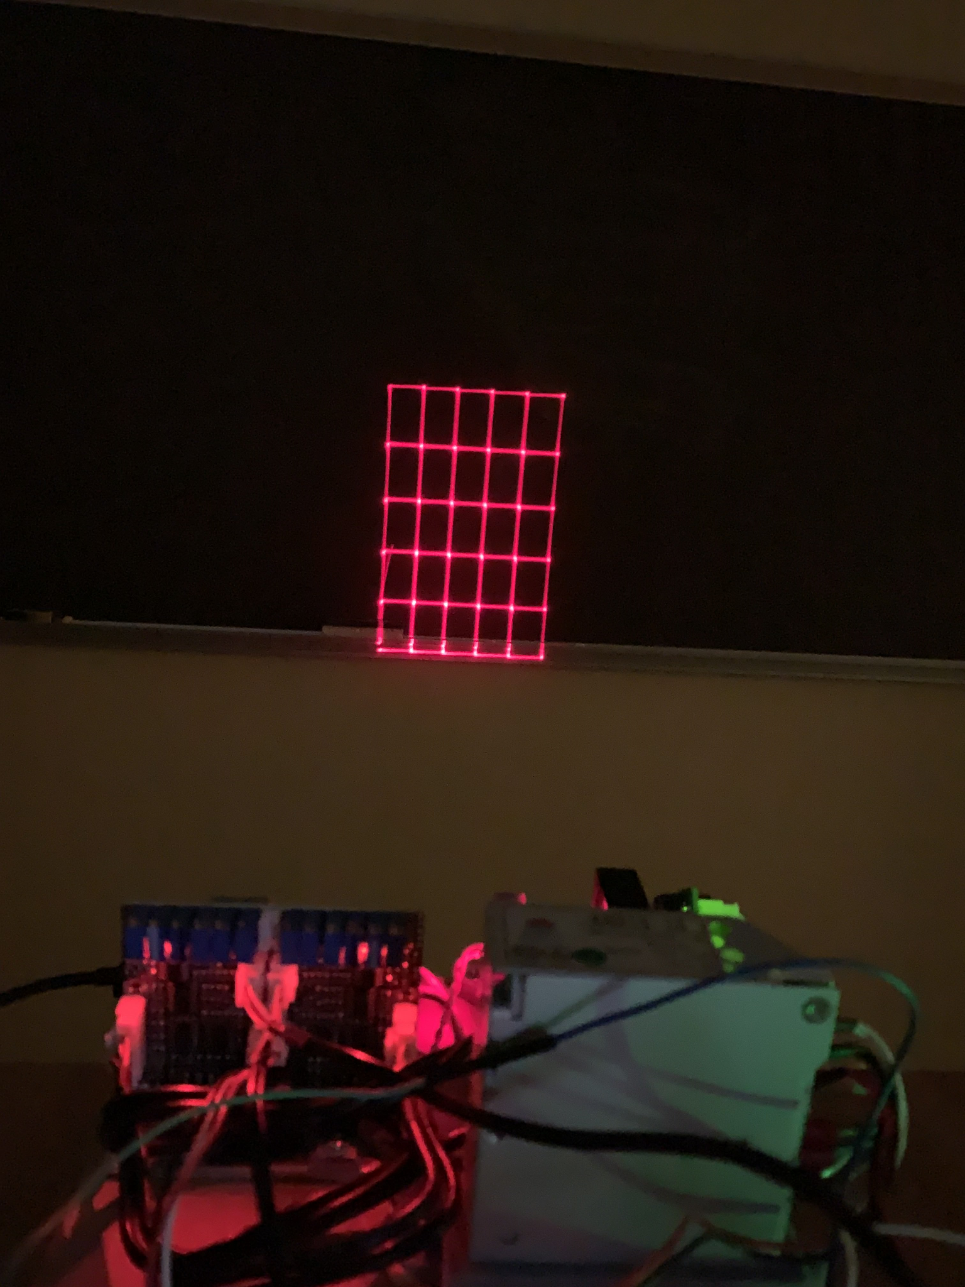
Laser
Functional requirements
The Laser will shine a beam of light that will be modified by the galvos
The Laser will be toggled on and off by the microcontroller
Performance requirements
The Laser must be toggle fast enough to mitigate the appearances of “artifacts”
The Laser must be visible in nominal light environments
Operational requirements
The laser should be operated in an indoor environment.

Slide 21
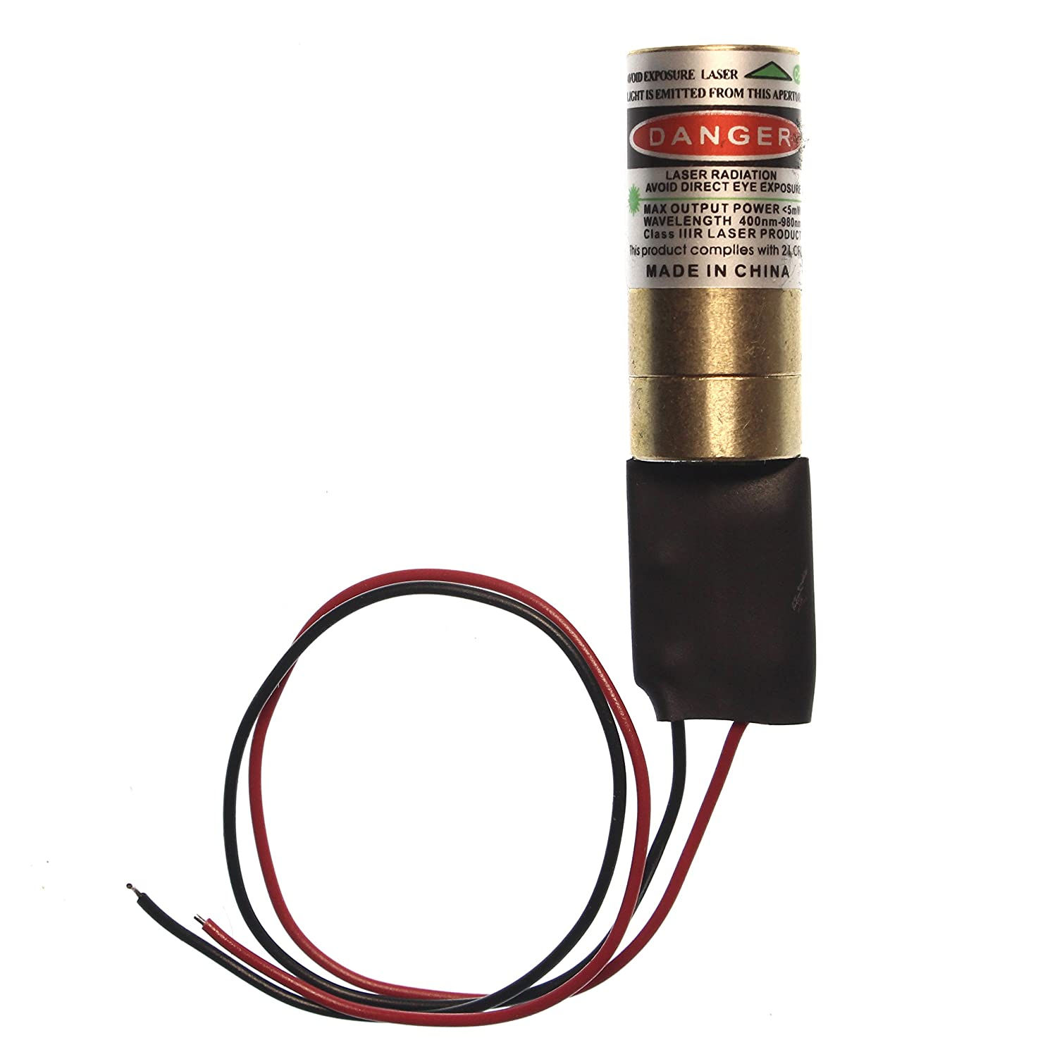
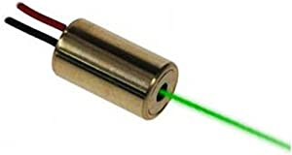
Laser: Trade Study
Class ii
<1mW
520 nm wavelength
No heatsink needed
Class iiiR
<5mW
532 nm wavelength
Heatsink Needed

Slide 22
Audio
Providing an audio effect when either of the participants score or win the game
Providing a control input to adjust the volume.
The nominal audio output signal shall be kept around -10 dBV.
The maximum audio output signal shall be kept around +10 dBV.
A 3.5 mm TRS jack shall be used as the output audio connector.

Slide 23
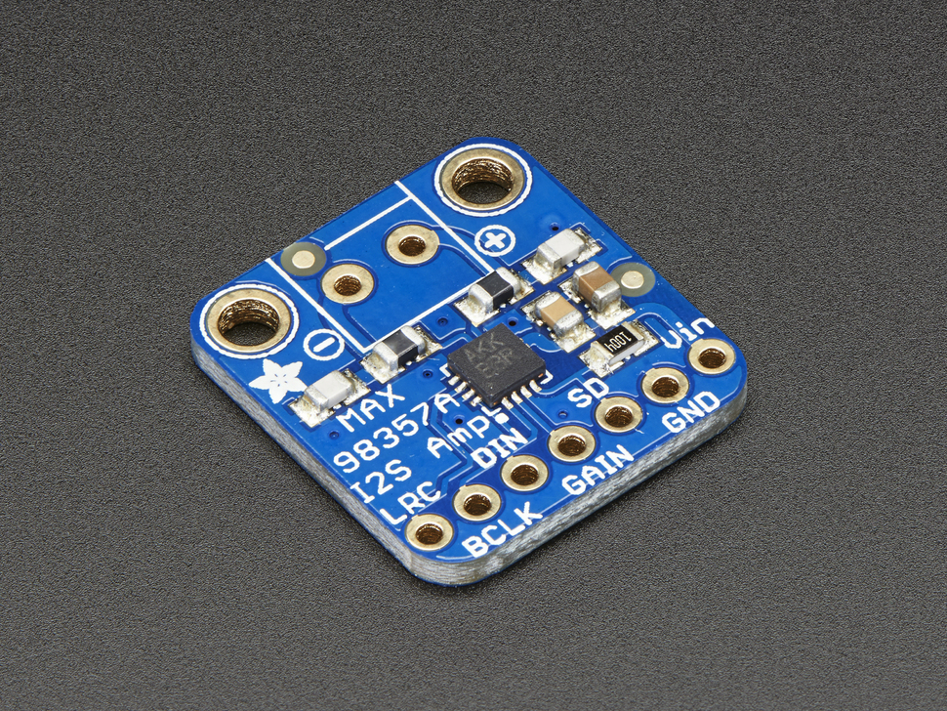
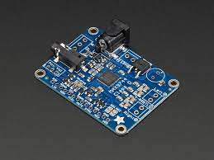
Audio: Trade Study
Adafruit MAX98357A 3W Amplifier
I2S
Adafruit MAX9744 20W Amplifier
Stereo Input

Slide 24
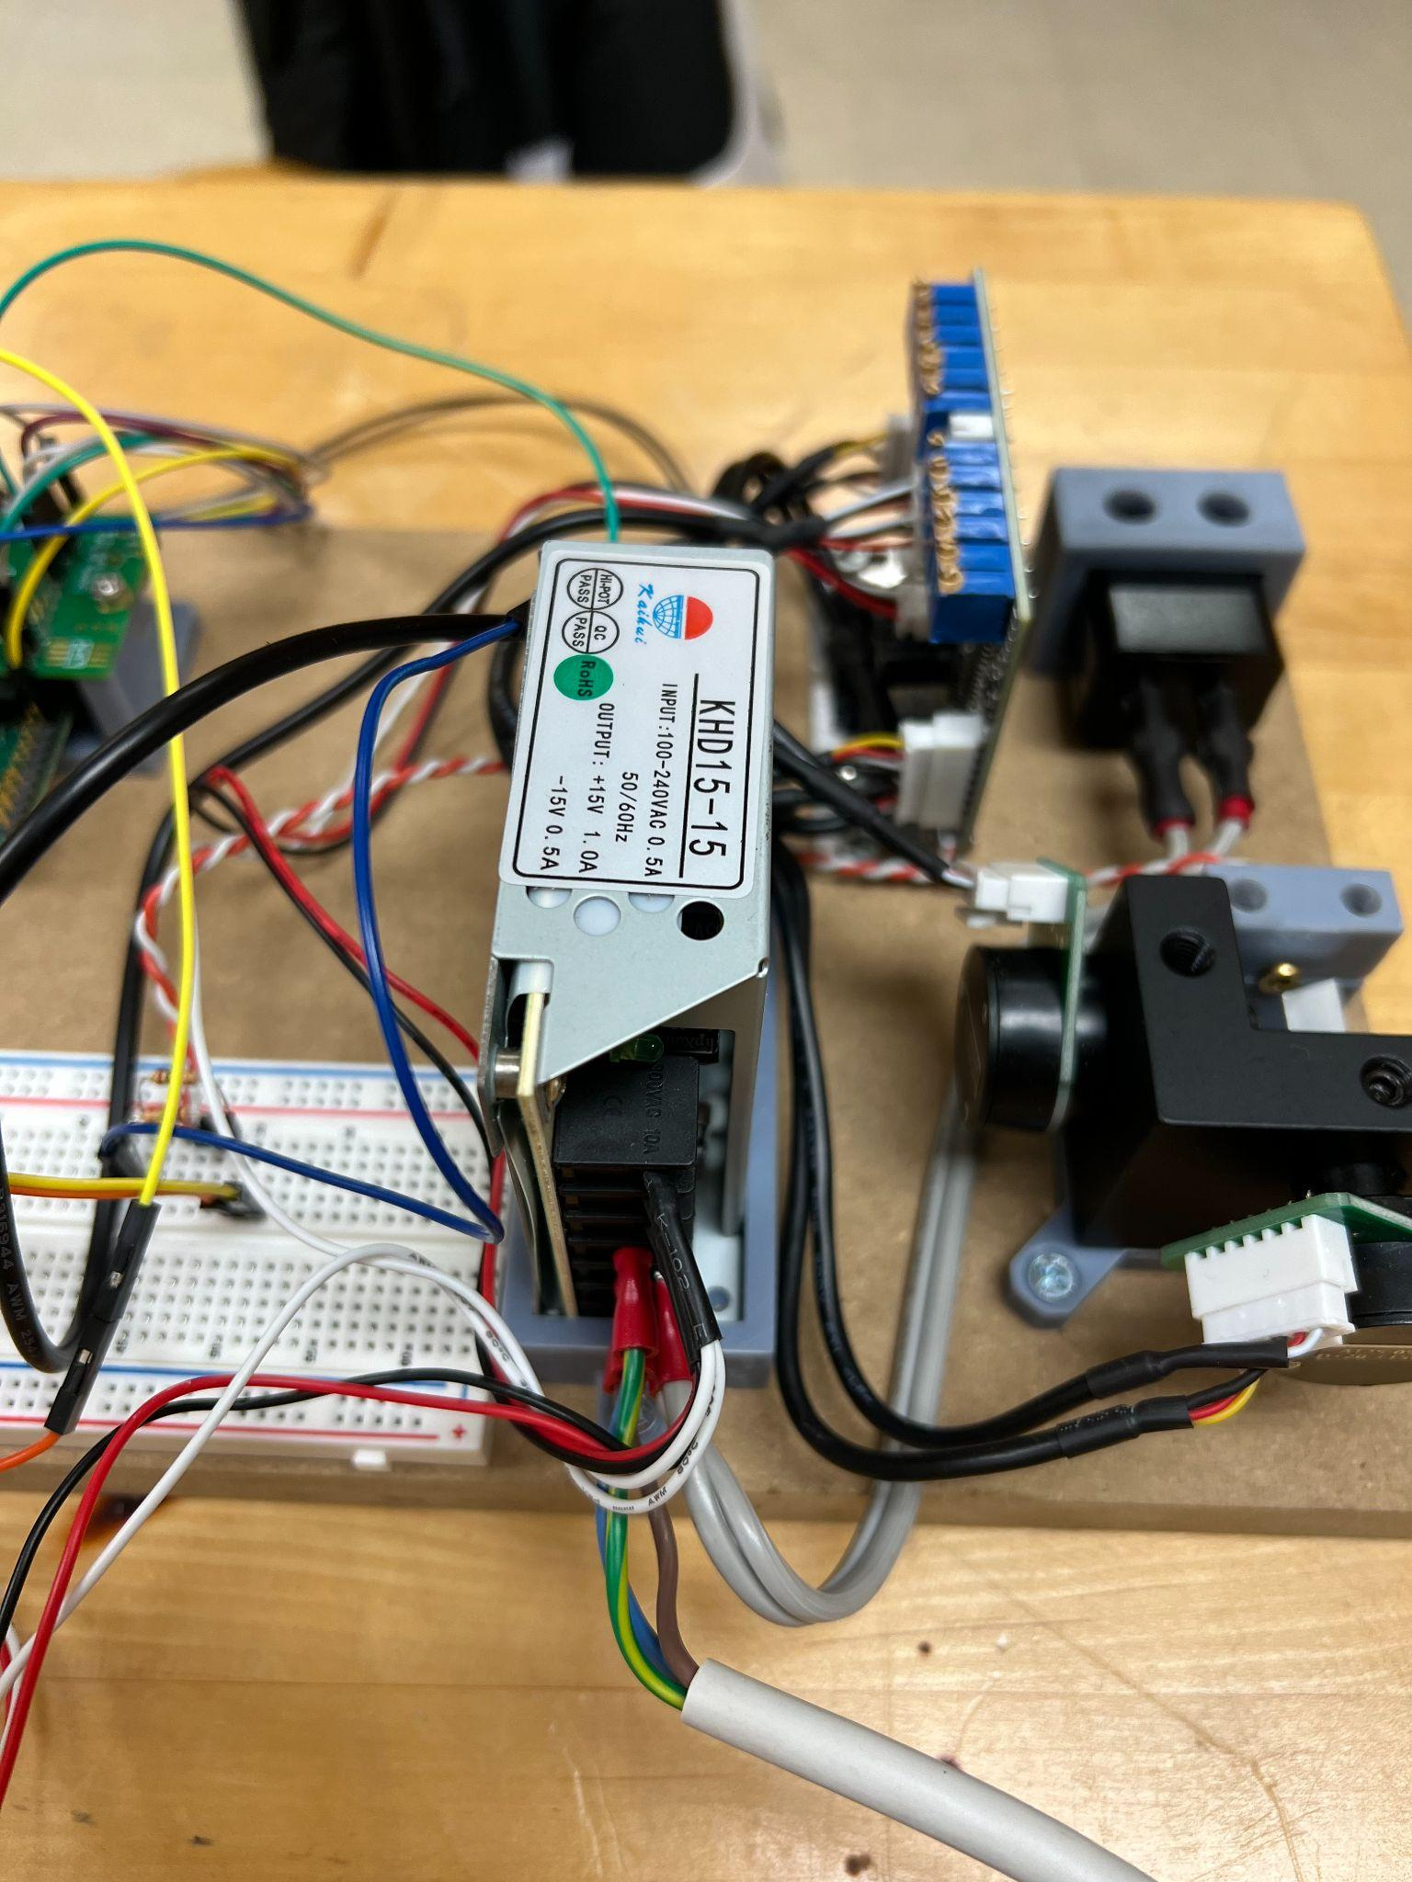
Power Supply
Functional requirements
100-240 VAC input with a +15V and -15V output.
Will provide the desired voltage for all of the components of the laser projector
Will power the laser projector when plugged into any outlet.
Performance requirements
Provide voltage with +0.5V and -0.5V accuracy
Operational requirements
Dry environment

Slide 25
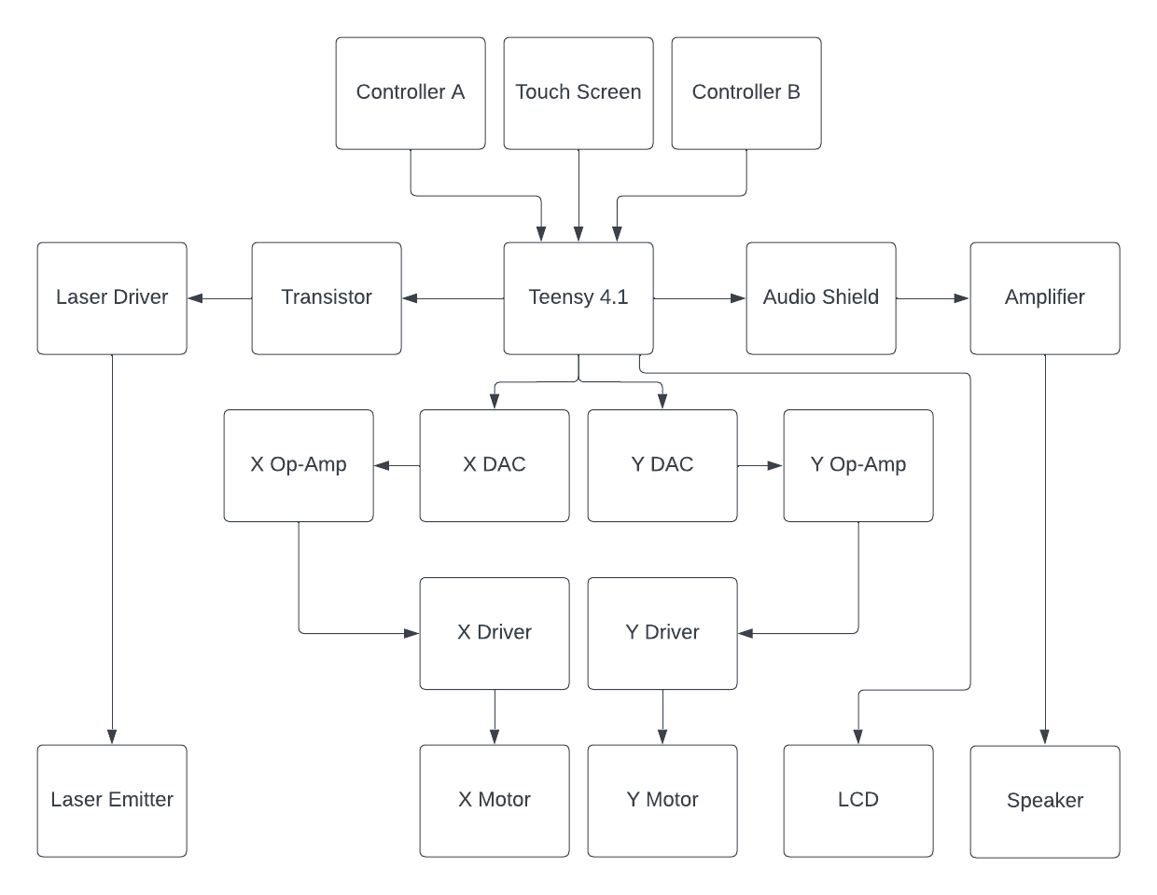
Hardware Flow

Slide 26
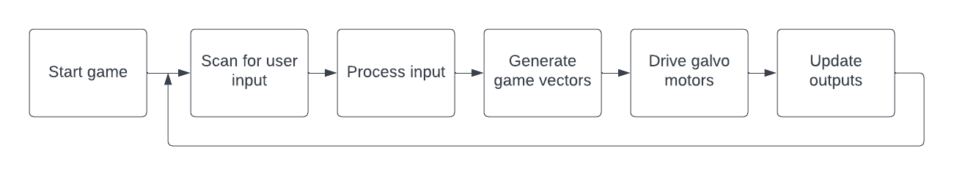
Software Flow

Slide 27
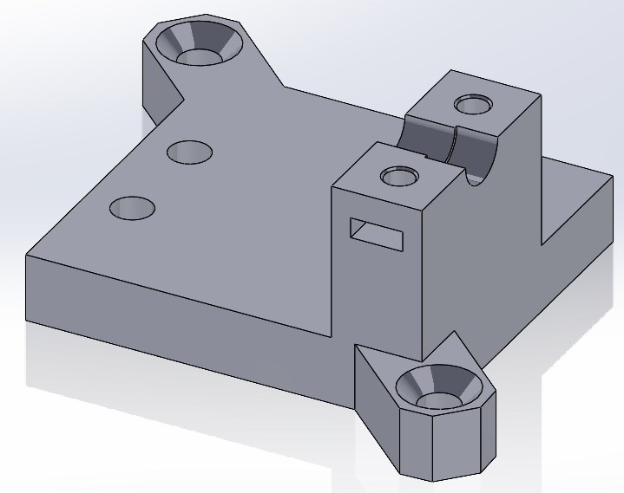
CAD
Shown is an early prototype for the galvo / laser mount

Slide 28
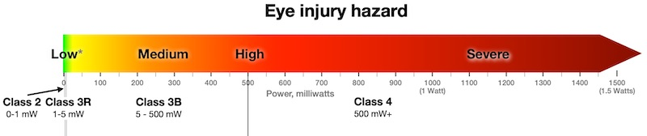
Technical Risk Analysis and Mitigation
Galvo And Galvo Driver
A slight bias towards the X-Dim as the laser shines into the X-Dim Galvo first.
Heating issues after prolonged use.
DAC
No mechanism to sync execution between the galvo channels creating “zig-zag” pattern while drawing diagonal lines.
Power Supply
Due to the nature of having a 120V AC terminal exposed to air, this subsystem provides a major safety concern
To mitigate this risk, a chassis must be provided which prevents the user from making contact with any live portions of the power supply

Slide 29
Project Management Items

Slide 30
Team Organization Structure
Meeting as a group Monday, Wednesday, Thursday and Friday on a weekly basis to collaborate on tasks at hand and what to do to keep moving forward
Utilizing google drive to share and keep track of all documentation for the project
Communicating through several applications to collaborate amongst team members

Slide 31
Management Roles
Ian Gant - Hardware
In charge of component selection, circuit design and preliminary hardware testing. Additionally, responsible for case construction and high voltage safety assurance.
Dominic Benintendi - Software
In charge of overall software organization and scope. Responsible for project file structure and IDE management, along with Class structure for the system code.
Drew Edmonds - Management
In charge of meeting planning as well as objective management. Responsible for documentation structure and project deadlines.
Adi Sahi - Operations
In charge of overall organization and analyzing data. Responsible for locating and addressing problems and issues, along with planning and reporting.

Slide 32
Project Schedule
Week | Tasks/Goals
1 (01/16/23-01/20/23) | Figure team schedule
2 (01/23/23-01/27/23) | Work on PDR slides
3 (01/30/23-02/03/23) | Present PDR slides
4 (02/06/23-02/10/23) | 2D motion control
5 (02/13/23-02/17/23) | Laser power control
6 (02/20/23-02/24/23) | Display multiple objects
Week | Tasks/Goals
7 (02/27/23-03/03/23) | Controllers
8 (03/06/23-03/10/23) | Code a library to display basic shapes
9 (03/13/23-03/17/23) | Code pong
10 (03/20/23-03/24/23) | Display Pong using library
11 (03/27/23-03/31/23) | Troubleshooting
12 (04/03/23-04/07/23) | Functioning Laser Projector
13 (04/10/23-04/14/23) | Expo Presentation

Slide 33
Resource Allocation
Additional parts can be ordered through Dan when necessary.
The team has a set budget of $500 for the project.
The senior lab will be used to construct and experiment with the laser projector.
Software readily available
Personal 3D printing available
Machining and fabrication services available in Stocker 011

Slide 34
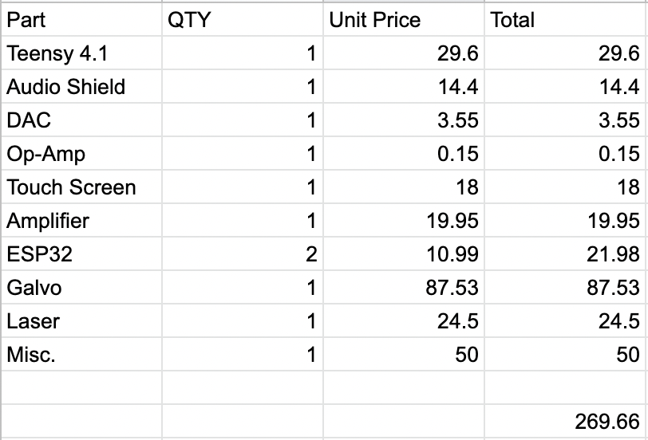
Budget

Slide 35
Intellectual Property
Software
Schematics will be intellectual property of the Laser Pong team collectively
CAD Models and PCB Design will be intellectual property of Ian Gant

Slide 36
Summary

Slide 37
Summary & Conclusions
Main Accomplishments
Prototype board
Touchscreen
Laser projection with galvos
Microcontroller sending signal to DAC
DAC signal processing
Risk Assessment
Laser strength
Galvos running hot
Standing issues
Galvo heat
DAC resolution
Confidence level assessment
We are at a 8/10
Basic prototype with laser control
Issues regarding galvo speed and resolution

Slide 38
Way Forward
How to address standing issues
Consider applying heat sinks to galvo clamp to mitigate heat buildup
Consider using SPI bus protocol for digital to analog conversion (DAC) due to increased bandwidth and resolution
Summary plan for detailed design phase
Begin recording and designing circuit schematics for existing hardware

Slide 39
Appendix/Supporting Material

Slide 40
Data Sheets
MCP4725 DAC
MCP4922 DAC
ILI9341 TFT LCD
ST7735 TFT LCD
MAX98357A Amplifier
MAX9744 Amplifier
https://www.pjrc.com/

